Slide 1
Paint your Zoom Background: Portrait Segmentation for Video Stylization
Yiwei Zhang zhang2486@wisc.edu

Slide 2
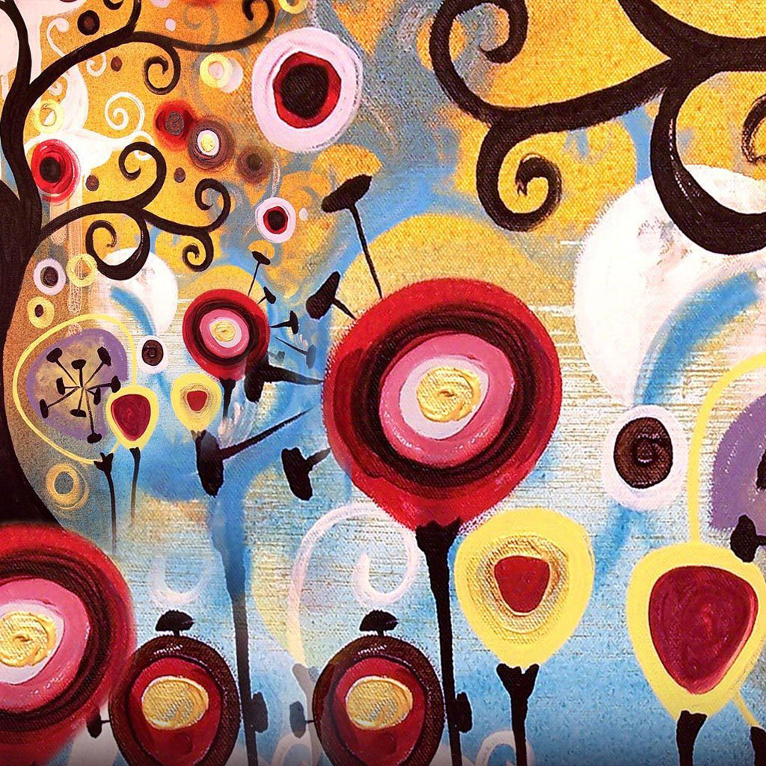
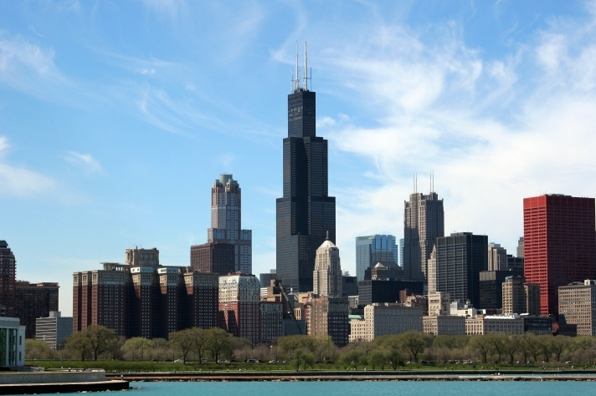
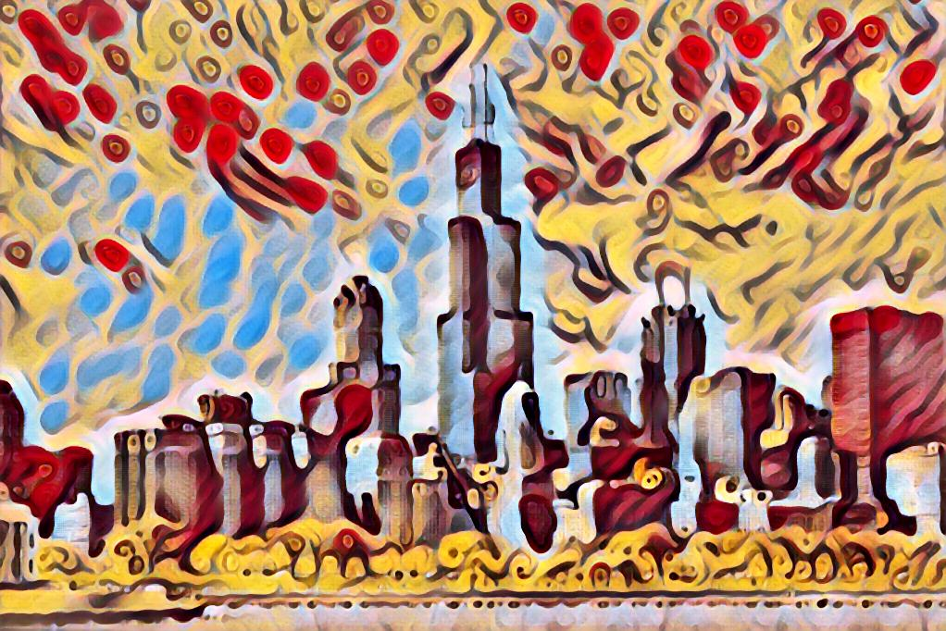
Neural Style Transfer
Style
Content
Result
Notes:
The term image style transfer, or alternatively image stylization, refers to the image processing task that extracts the feature of style of a set of images, and apply such style onto another set of images. Although this kind of style transfer operation has achieved good performance when the to-be-stylized images are landscape photographs, it sometimes meet limitations when the photographs contain other elements, for example, a photo that contains a portrait. By noticing this issue, we come up with the idea that developing a better image style transfer method for photograph that contains both portrait and landscape. The implementation consists of two major parts, first we need to extract the portrait out of the photograph, and second, apply different style transfer on portrait and landscape separately, and later combining them together.

Slide 3
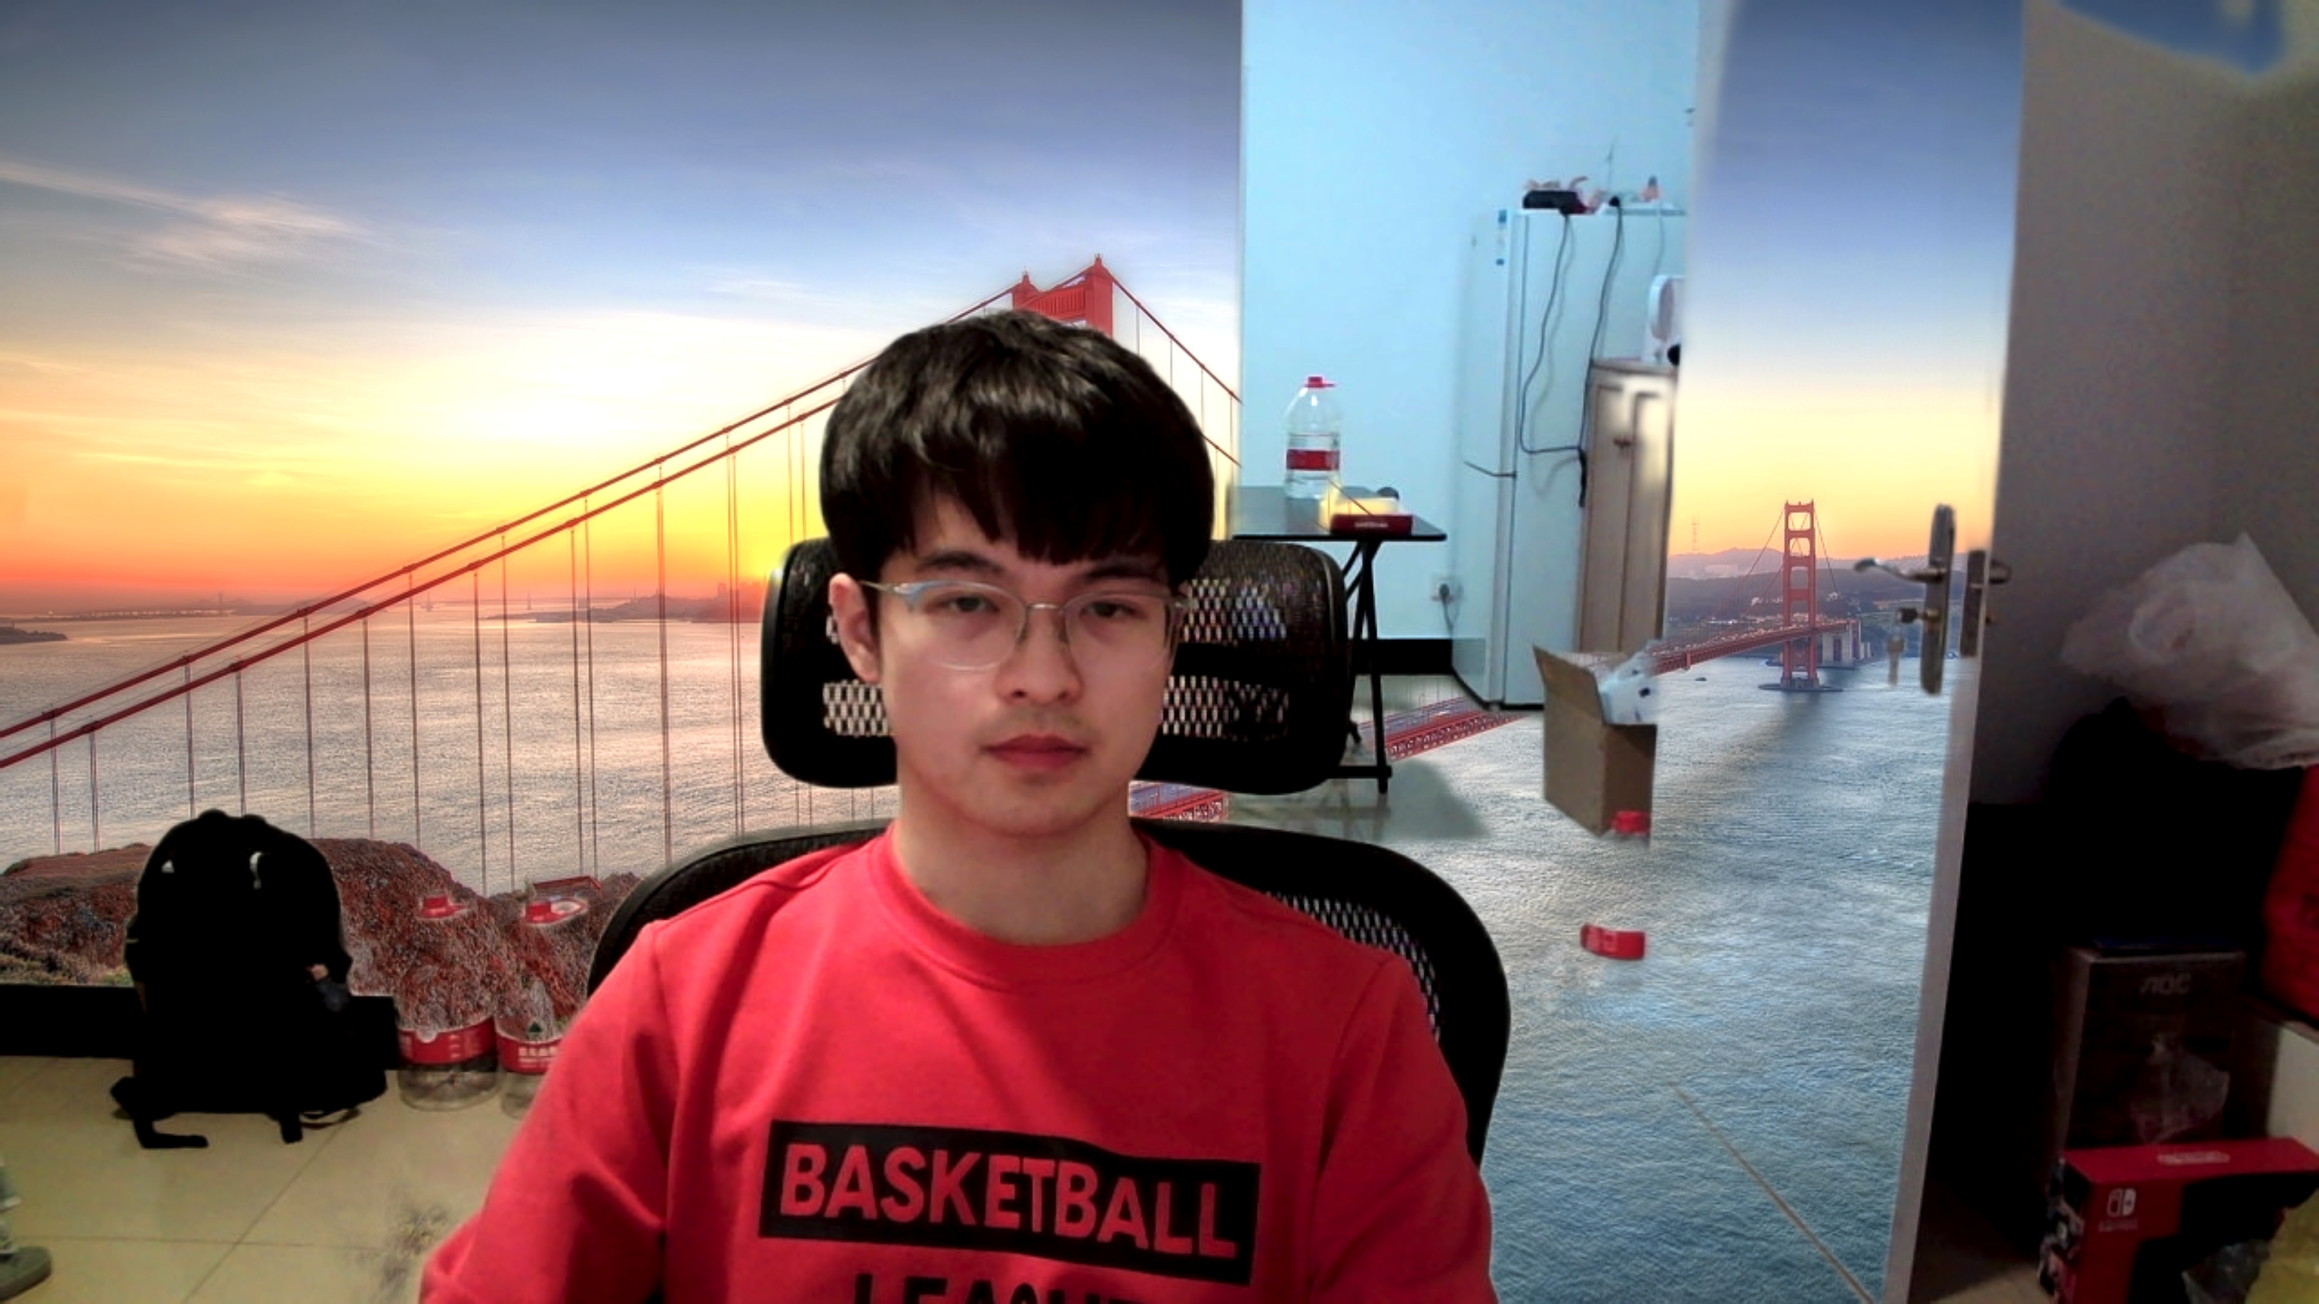
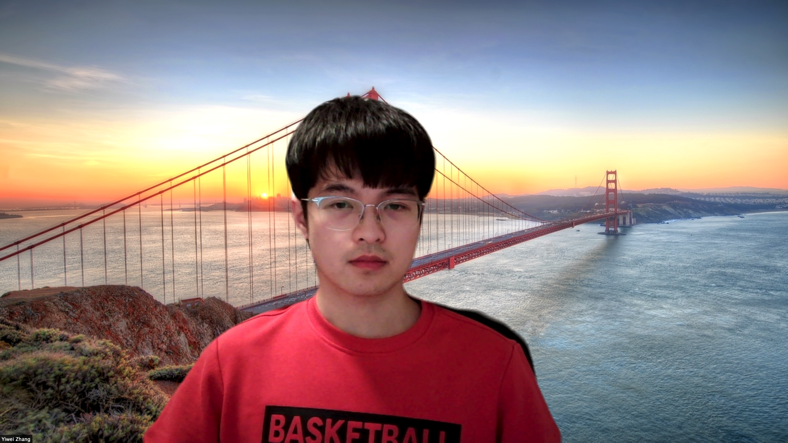
Motivation
Current Zoom Background

Slide 4
Approach
Dump frames and audio file from the video file
Generate person segmentation masks
Apply neural style transfer on dumped frames
Combine masks and stylized frames, mask out person or background
Create result videos

Slide 5
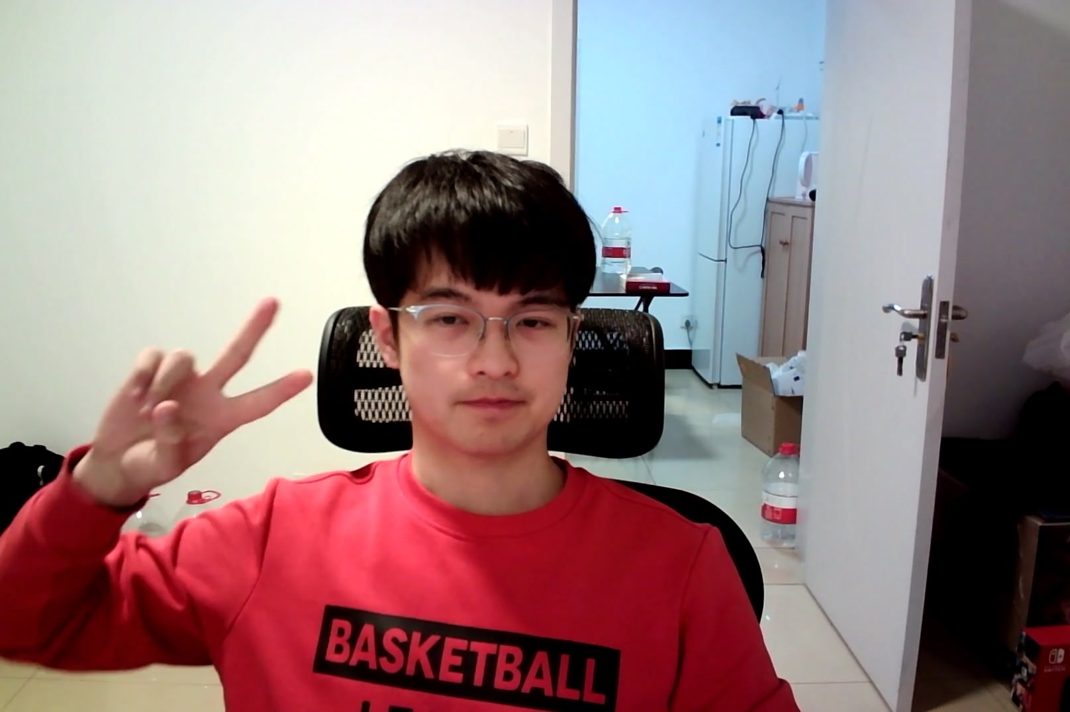
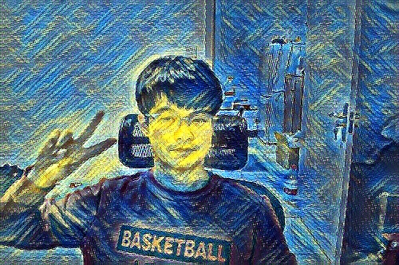
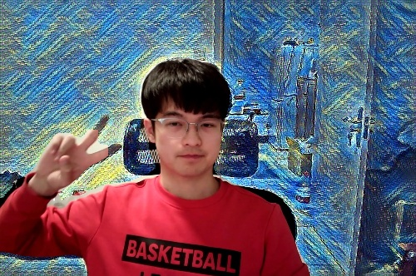
Implementation
Segmentation
DEEPLABV3-
RESNET101
Stylization

Slide 6
Implementation

Slide 7
Results
Original

Slide 8
Results
Fully Transferred

Slide 9
Results
Partially Transferred

Slide 10
Results
Combined

Slide 11
Future Work
Apply image blending near the boundary
Increase inference speed for real-time deployment

Slide 12
Questions?

Slide 13
Reference
[1] Johnson, J., Alahi, A., & Fei-Fei, L. (2016). Perceptual Losses for Real-Time Style Transfer and Super-Resolution. ECCV.
[2] Chen, L., Papandreou, G., Schroff, F., & Adam, H. (2017). Rethinking Atrous Convolution for Semantic Image Segmentation. ArXiv, abs/1706.05587.
[3] Chen, L., Zhu, Y., Papandreou, G., Schroff, F., & Adam, H. (2018). Encoder-Decoder with Atrous Separable Convolution for Semantic Image Segmentation. ECCV.
[4] Shen, X., Hertzmann, A., Jia, J., Paris, S., Price, B.L., Shechtman, E., & Sachs, I. (2016). Automatic Portrait Segmentation for Image Stylization. Computer Graphics Forum, 35.
[5] Gatys, L.A., Ecker, A.S., & Bethge, M. (2016). Image Style Transfer Using Convolutional Neural Networks. 2016 IEEE Conference on Computer Vision and Pattern Recognition (CVPR), 2414-2423.

